Slide 1
SQL injection breakthrough database BY:Ahmed elmaloul 16030441006

Slide 2
Introduction:
SQL, or Structured Query Language, is a computer language for managing databases. This includes discovering data quickly, updating it, and deleting it. Several websites, such as e-commerce sites and investment firms, have large databases that store information about millions of customers, and they manage such databases using SQL.

Slide 3
When someone log it into a website that maintains information about them, for example, it may utilize SQL to seek up their usernames in a table and then retrieve related account information. If you make a change to your account (for example, your mailing address), SQL would overwrite each old address in the database and replace it with the new one.

Slide 4
These databases frequently contain sensitive personal data such as phone numbers, email and mailing addresses, as well as credit card and social security numbers (Although very sensitive data must be encrypted rather than stored in plaintext, this is not always the case). Just authorized users should have access to particular database information. Individual users may usually view their own information on a website, whereas a website administrator may have entry to every users' information.

Slide 5
Considering data must be kept someplace, nearly every system & website nowadays uses a database. Because sensitive data is kept in the database, the security of the system is endangered. When data from a personal website or blog is taken, the impact is minor compared to data stolen from its financial system.

Slide 6
, SQL injection take place, whenever you request a user for information, such as his username/use id, but rather than a name/id, the user provides you a SQL statement that you unintentionally perform in your database

Slide 7
History
During 1998, the very first published discussions regarding SQL injection began to appear; for instance, 1998 article in Phrack Magazine.

Slide 8
The Open web Application Security Project named SQL injection (SQLI) as one of the top ten web application vulnerabilities in 2007 and 2010. On the OWASP top ten list in 2013, SQLI was ranked number one.

Slide 9
SQL injection can be divided into four types:
Classic SQLI
Blind or Inference SQL injection
Database management system-specific SQLI
Compounded SQLI

Slide 10
SQL Injection potentially led to the following outcomes:
The user might change the database's structure or even destroy tables from the database application.
The user could take control of the database server and execute commands on it at will.
Modifying any sensitive information in the system.
Hacking into someone else's account.
Critical information on the system is being deleted.

Slide 11
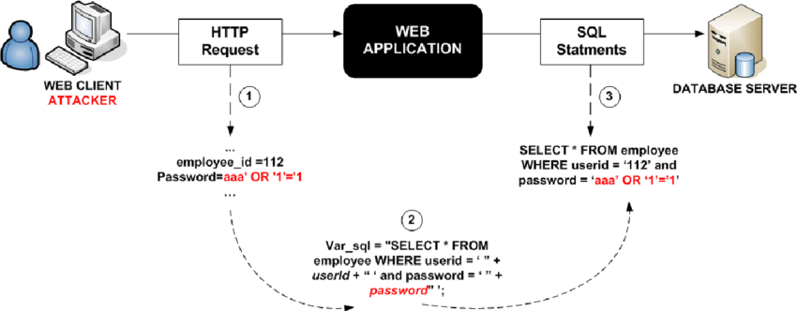

Slide 12
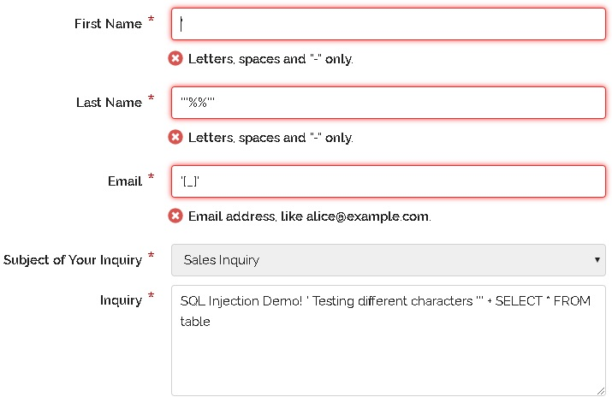

Slide 13
